Slide 1
Environment setup
Update at 2024/05/08

Slide 2
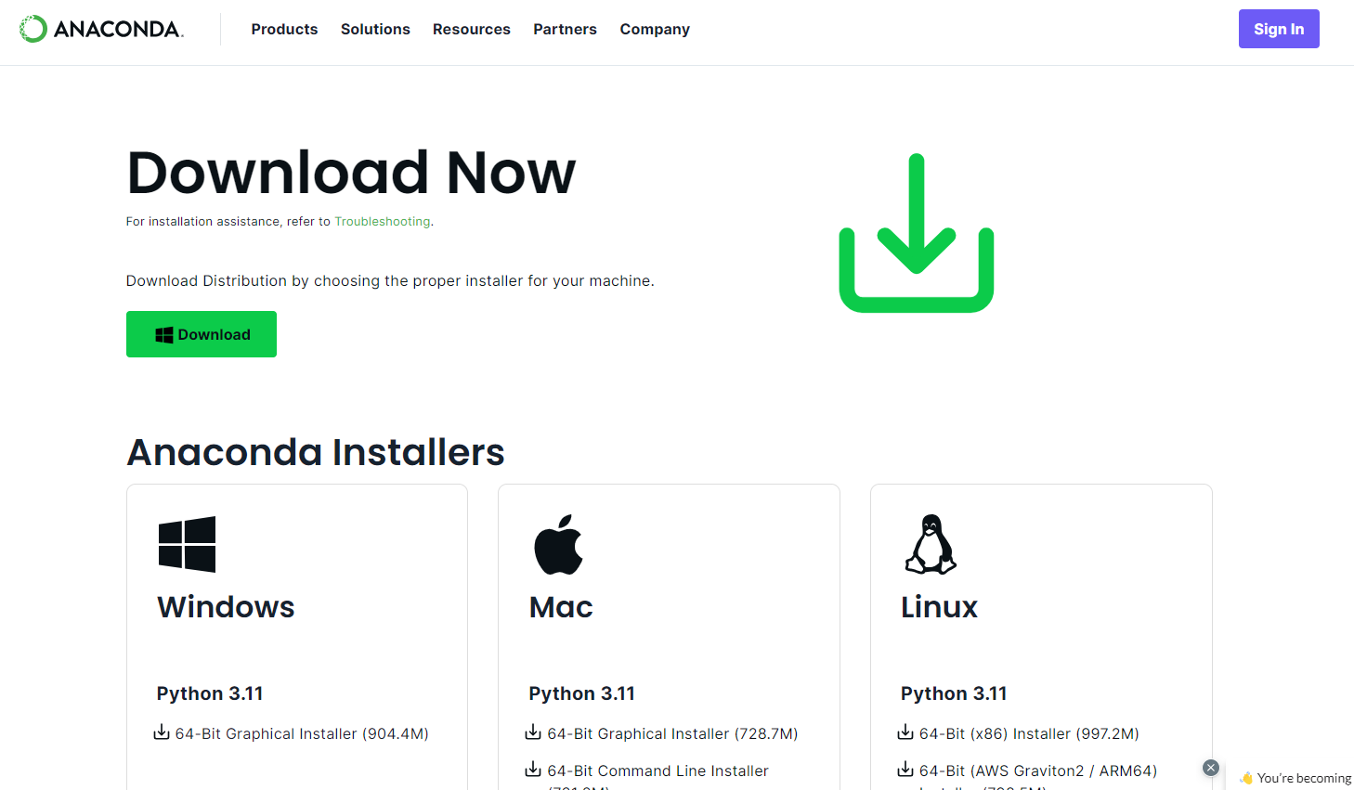
Anaconda
https://www.anaconda.com/download/success

Slide 3
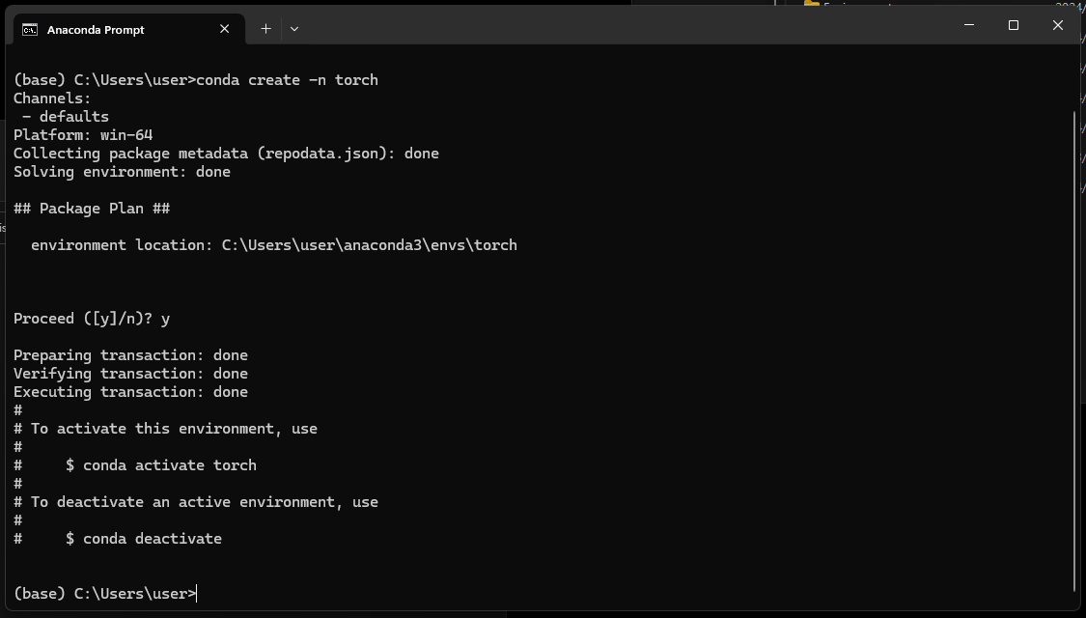
Anaconda: Create isolate environment
Open anaconda prompt: conda create –n <env_name>

Slide 4
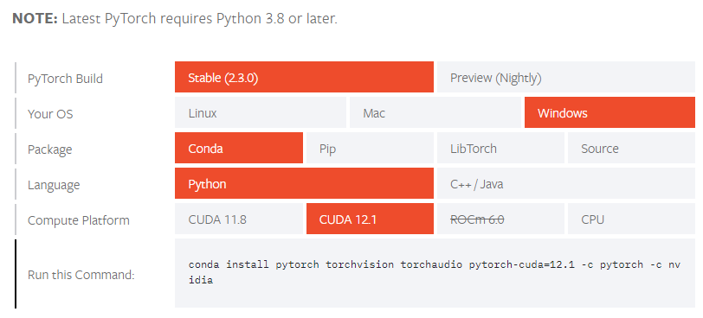
Anaconda: install IDE and torch inside the environment
Code: conda activate <env_name> conda install spyder conda install jupyter conda install pytorch torchvision torchaudio pytorch-cuda=12.1 -c pytorch -c nvidia
https://pytorch.org/get-started/locally/

Slide 5
Anaconda: install python package
Neuroimage: pip install nibabel simpleitk pydicom, antspyx (note that antspyx could only be installed for linux system)
Dataframe: pip install pandas xlrd openpyxl
Image process: pip install scikit-image opencv-python-headless matplotlib
ML: pip install scikit-learn
DL: pip install ultralytics
FL: pip install flwr

Slide 6
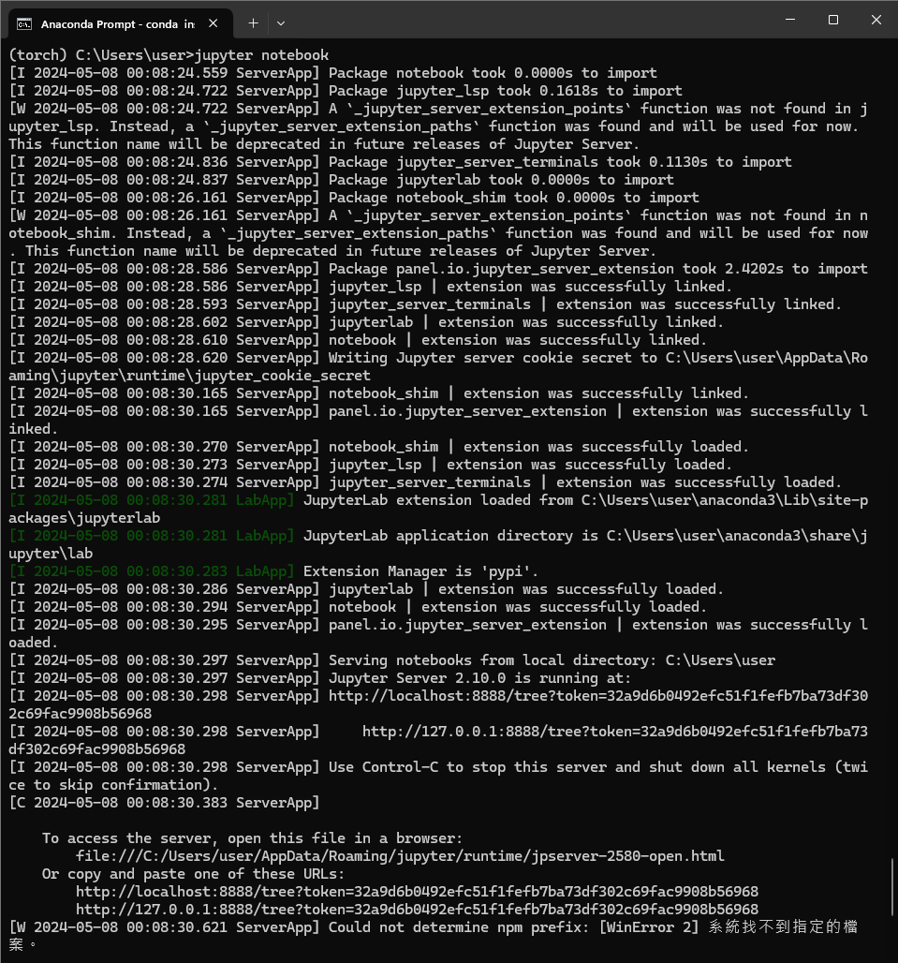
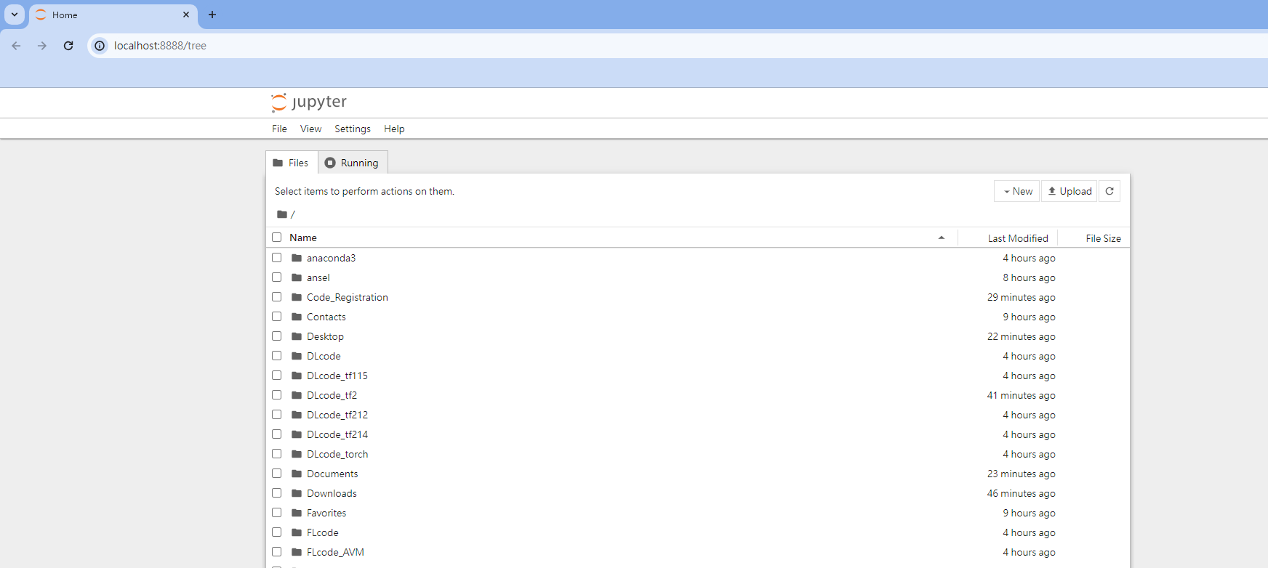
Anaconda: launch IDE -- jupyter
Code: conda activate <env_name> jupyter notebook
Browser would open the jupyter IDE

Slide 7
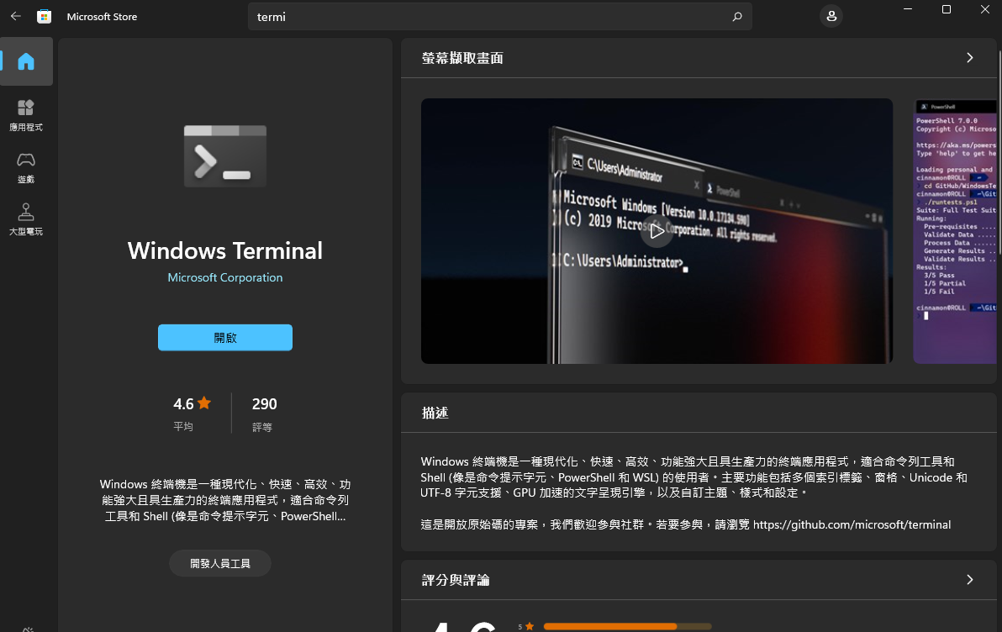
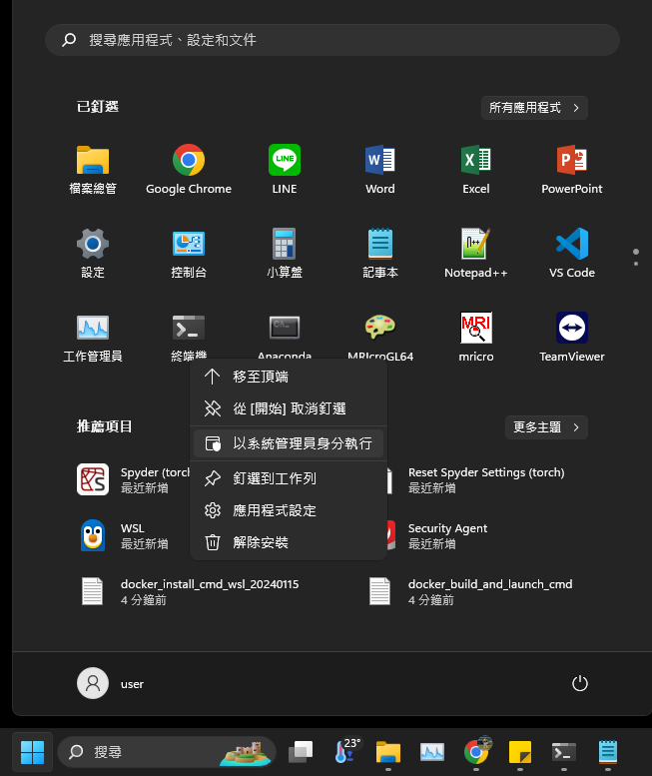
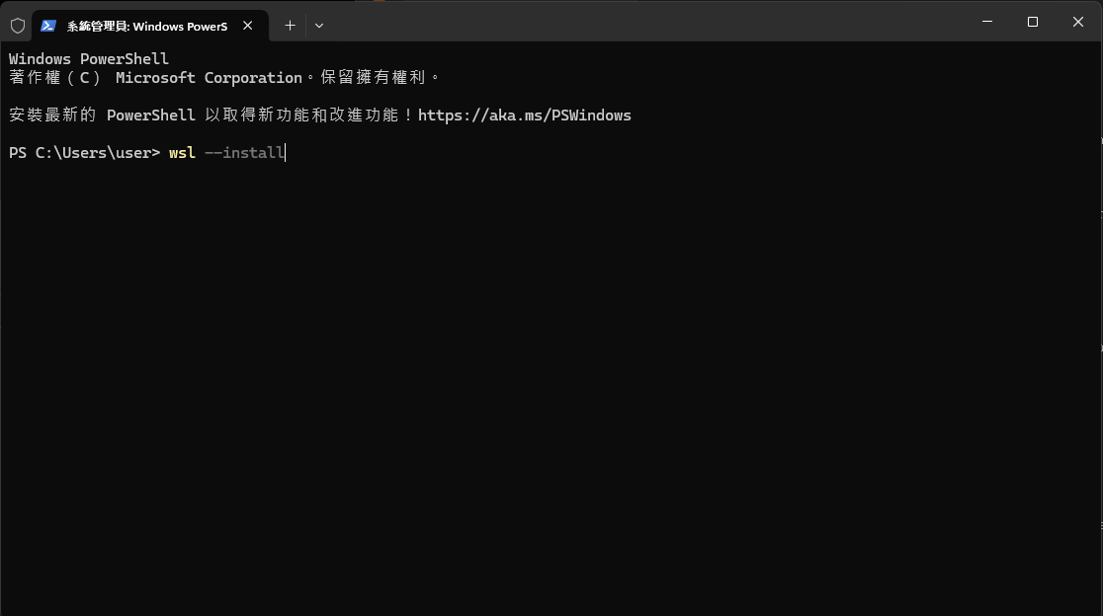
Windows Subsystem for Linux, WSL
https://learn.microsoft.com/zh-tw/windows/wsl/install
suggest download window terminal from microsoft store, that would be easier to operate
open windows powershell using administrator permission: wsl --install (for install), wsl --update (for update)

Slide 8
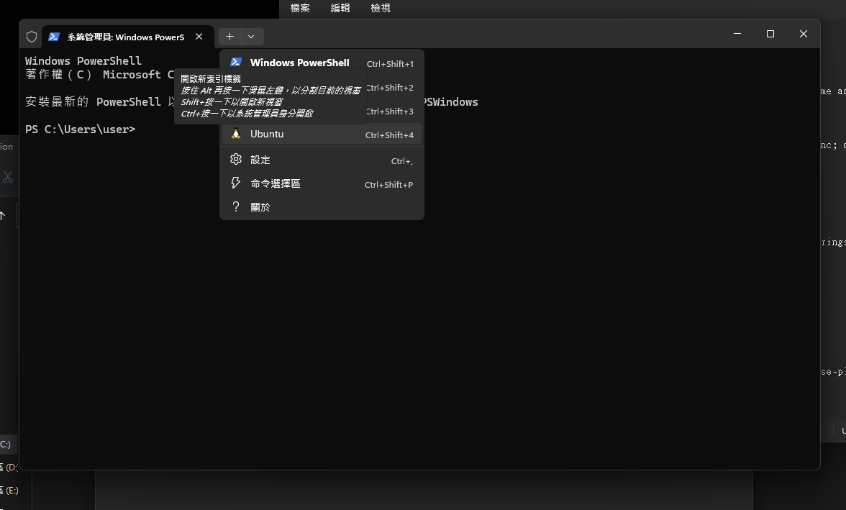
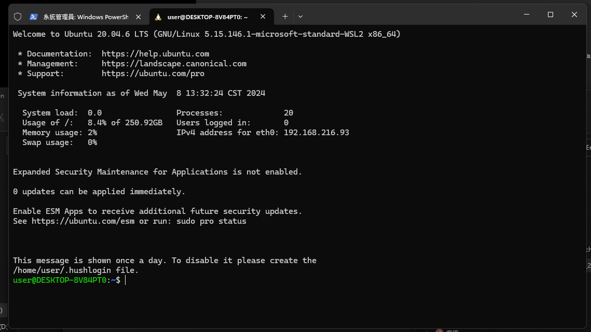
Windows Subsystem for Linux, WSL
Default linux OS is latest version of Ubuntu

Slide 9
WSL: docker install and build-up
Docker install: follow the command inside the docker_install_cmd_wsl_20240115
Docker build: follow the command inside the docker_build_and_launch_cmd
Note that the disk locations are shared with base OS: base OS: C:/ → WSL: /mnt/c/
If need to add additional pip packages, please add the package in the Dockerfile

Slide 10
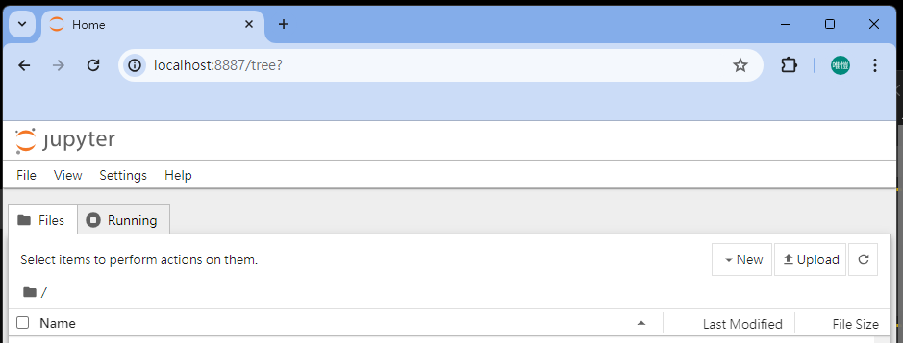
WSL: docker launch
Match the service port and disk location to the working directory inside the docker docker run --gpus all --shm-size=20gb -p 8887:8888 -v /mnt/c/Users/user:/workspace -v /mnt:/mnt -d torch
Type the url: localhost:8887 at browser

